Slide 1

Matias Flores
Anastasia Putuntica
Daniel Vaswani
Sarvin Satchithanantham
Luciano de Armas

Slide 2
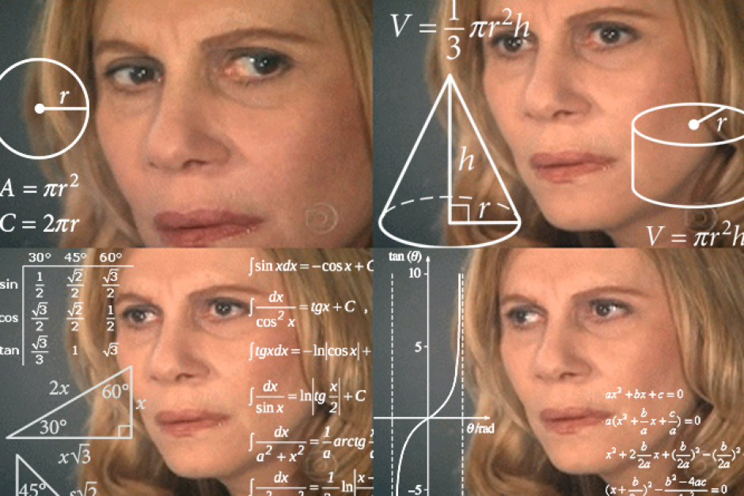

Slide 3
We are your solution

Slide 4
We offer a reliable tool to work with multiple clients BGS’, reducing the costs of your project.

Slide 5
Key points
Efficient tool
Multiple clients
Cost-effective

Slide 6
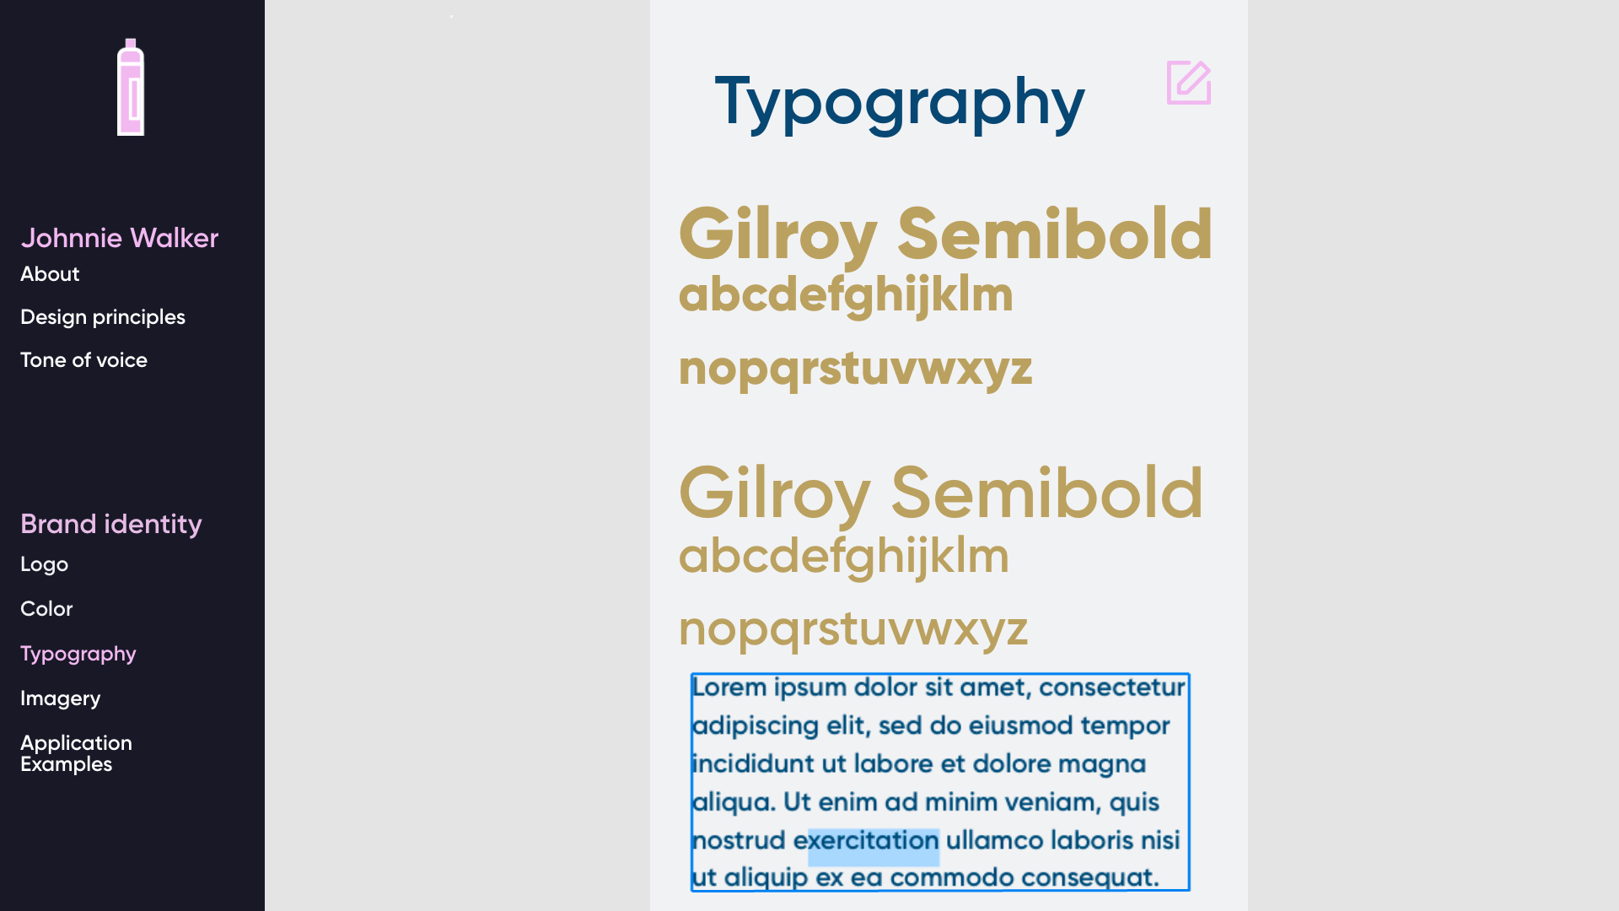

Slide 7
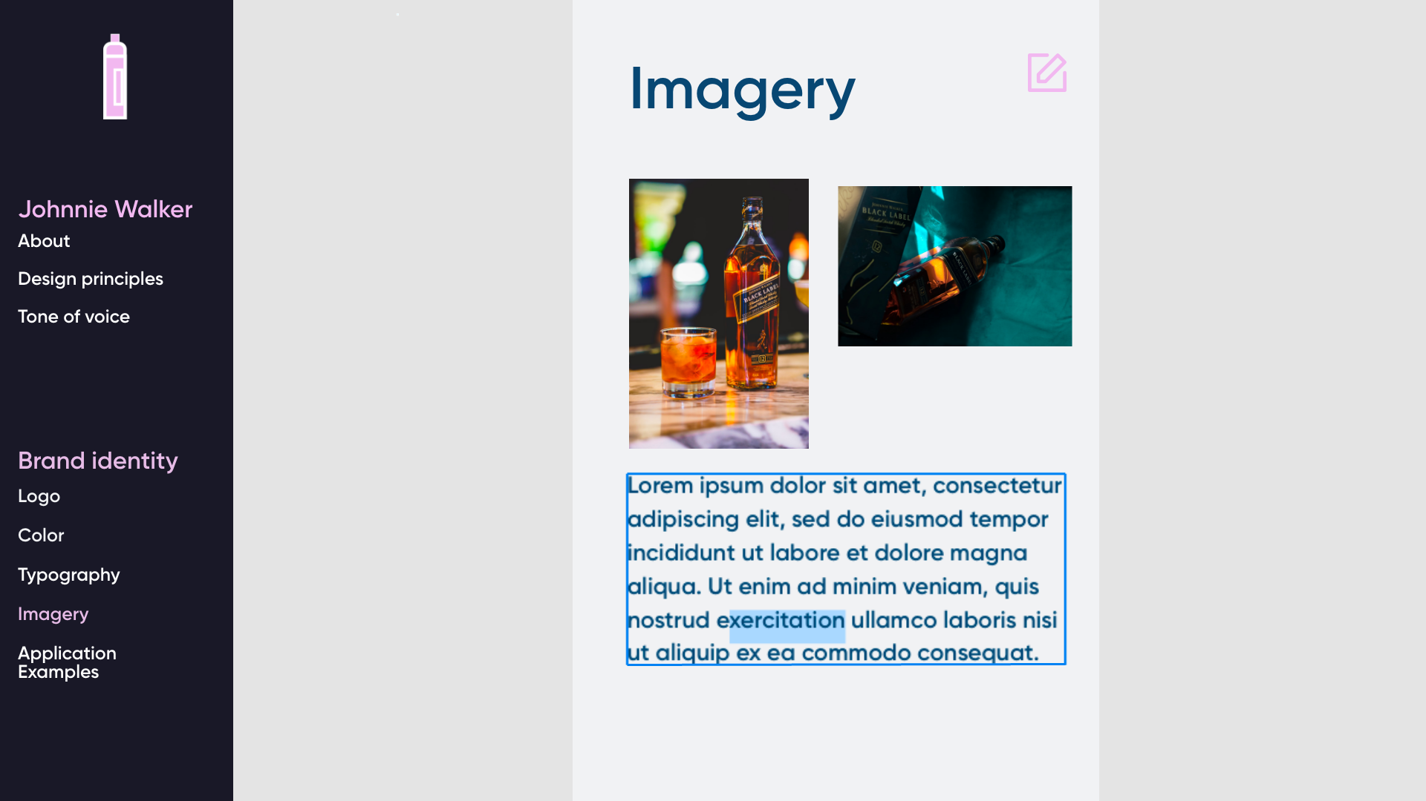

Slide 8
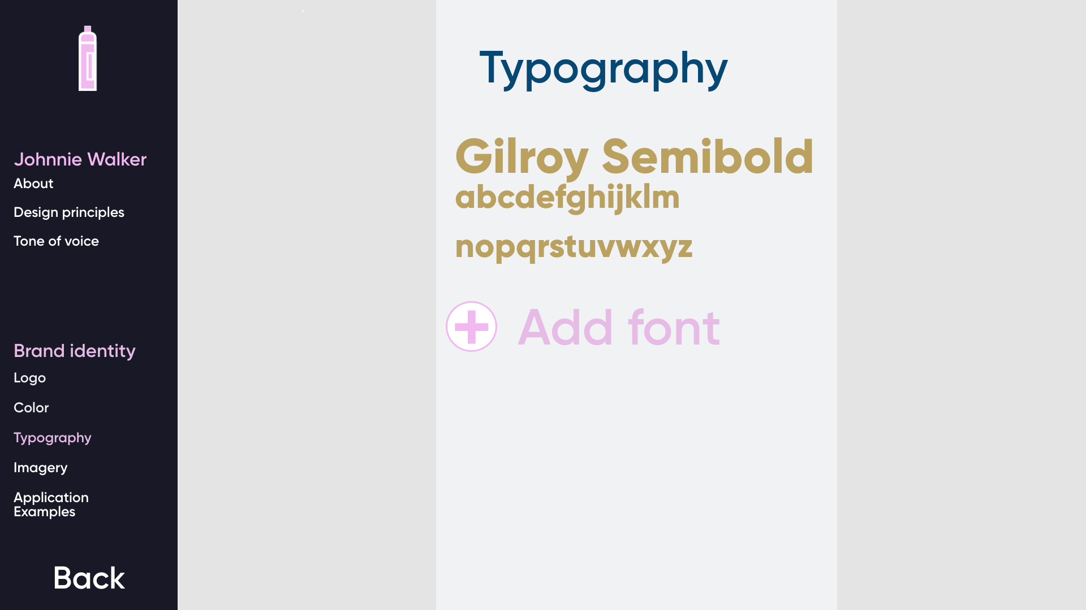

Slide 9
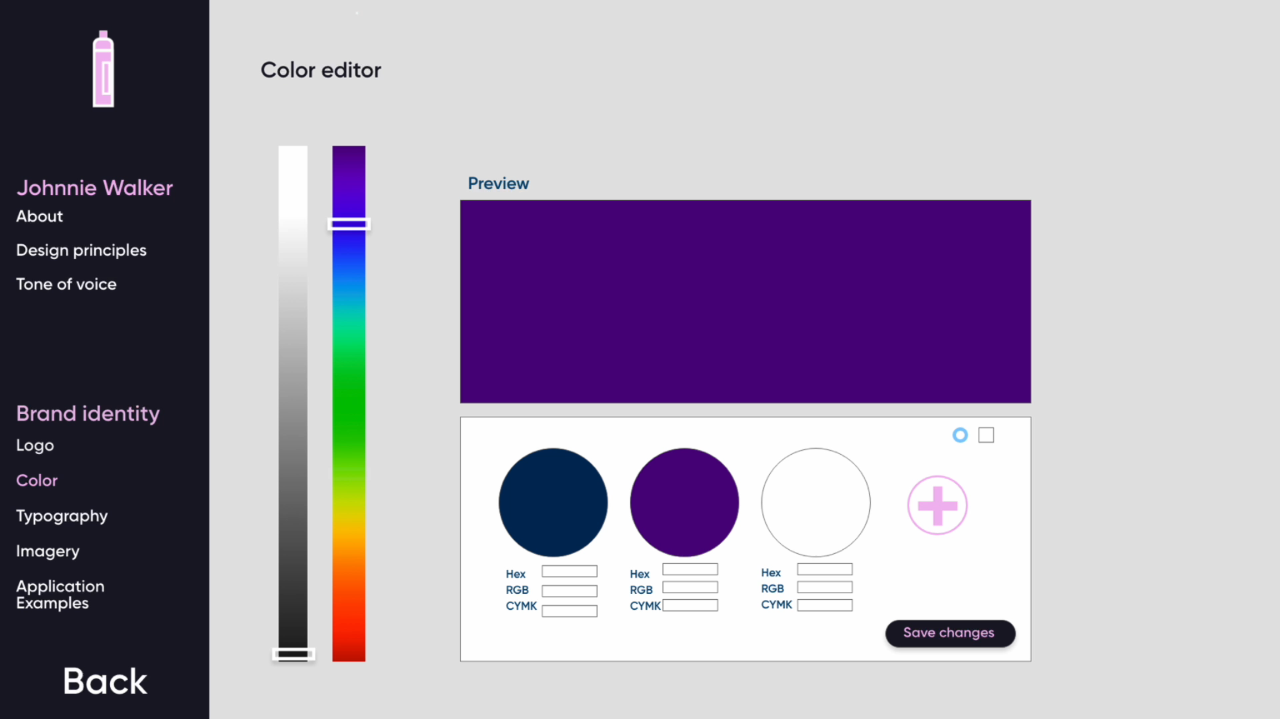

Slide 10
A brand needs a digital home

Slide 11
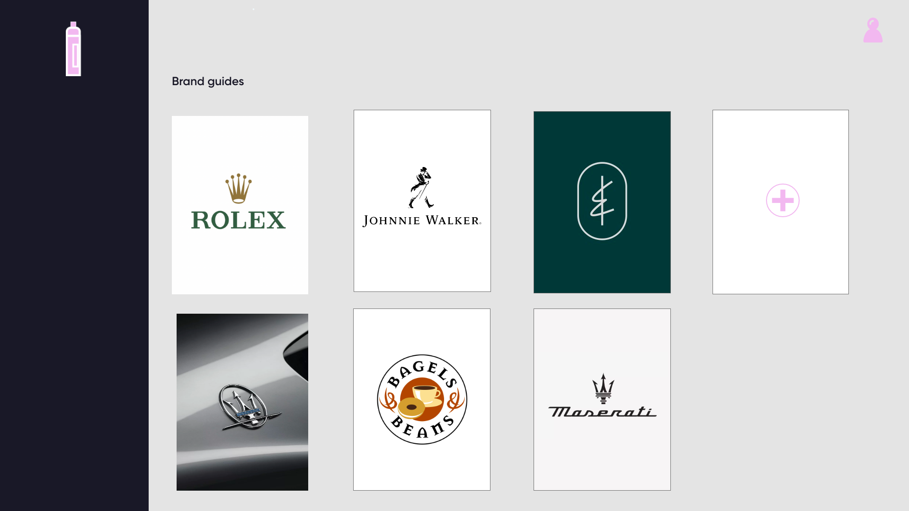

Slide 12
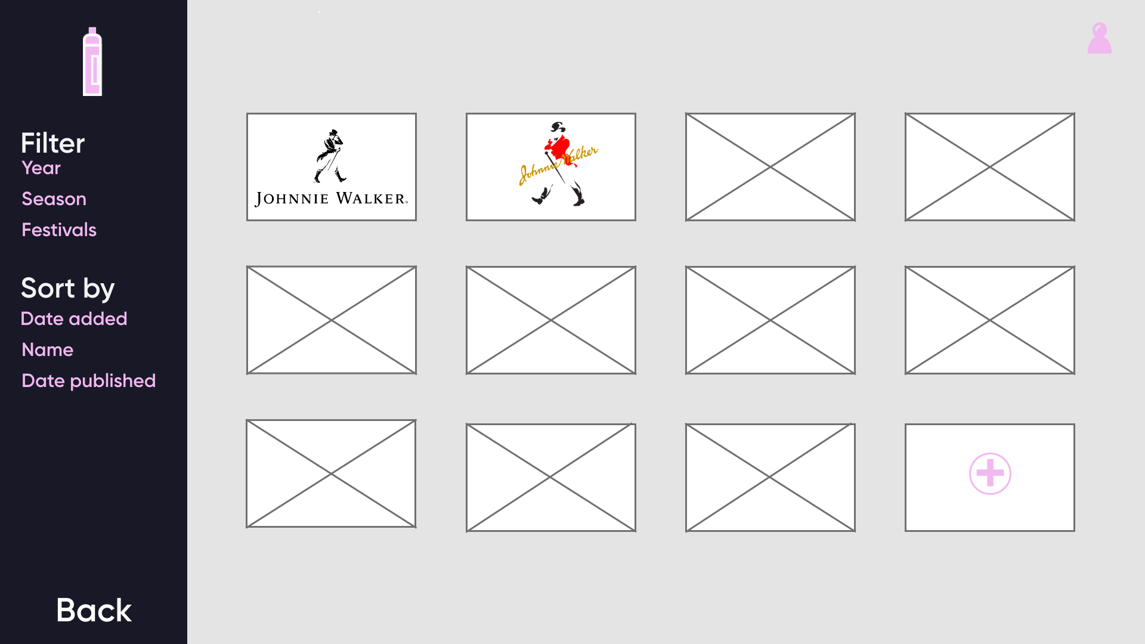

Slide 13


Slide 14
